Slide 1

Amplitude analysis of $Λ_{b}→J/ψpπ$ decay with run1 and run2
Zehua Xu , Liming Zhang

Slide 2
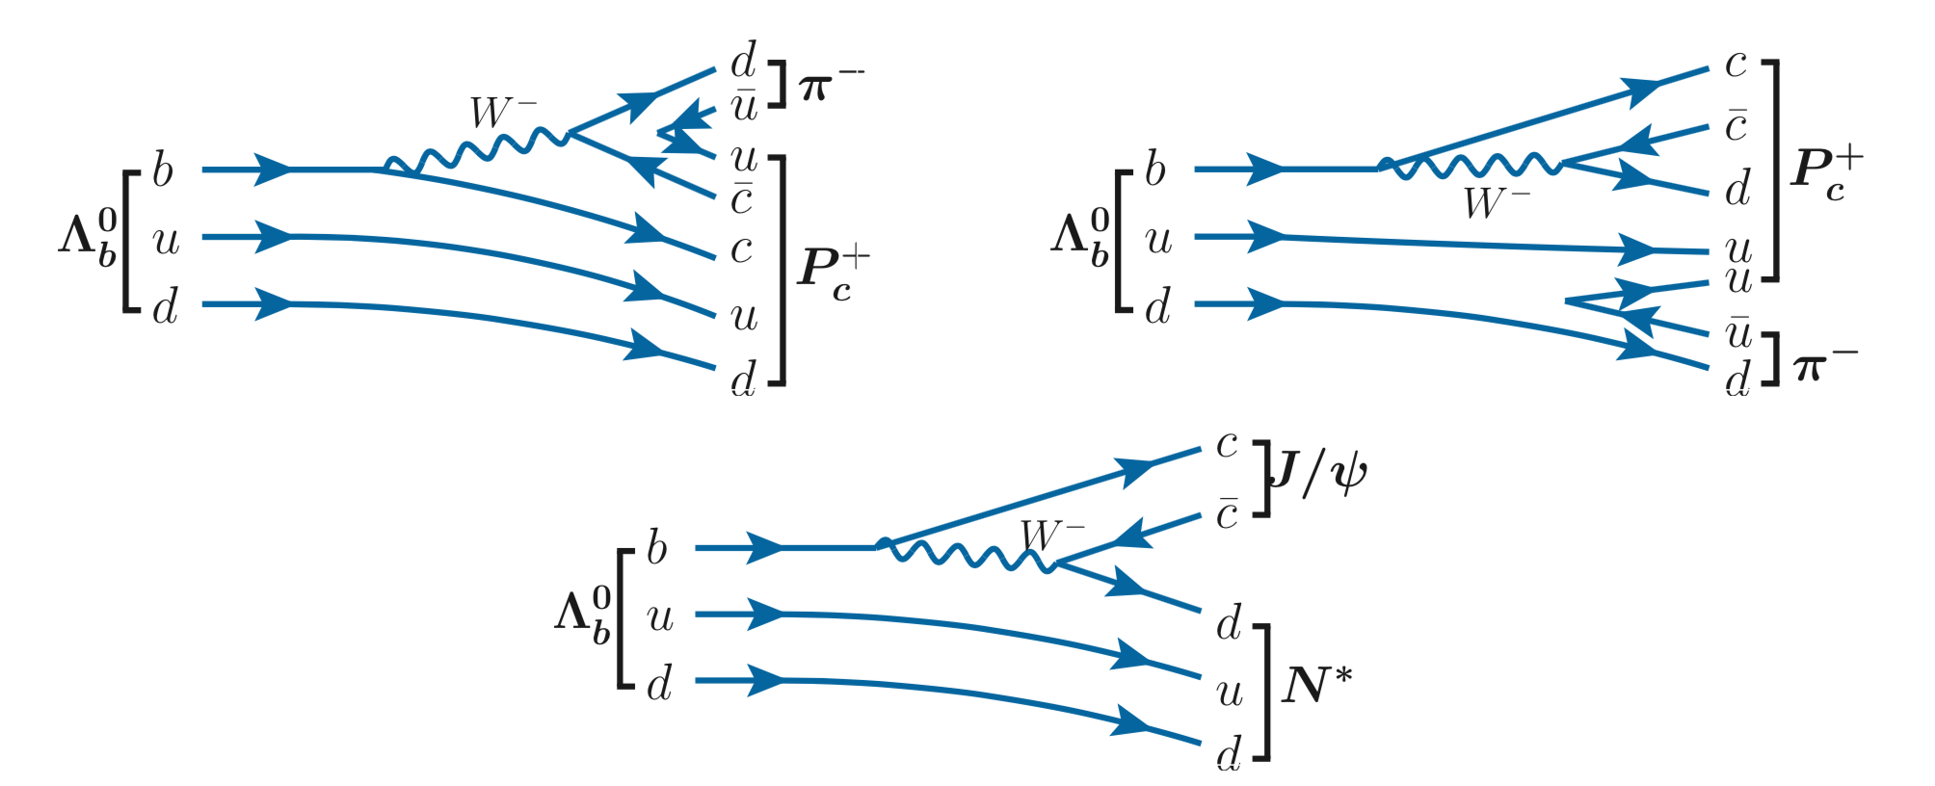
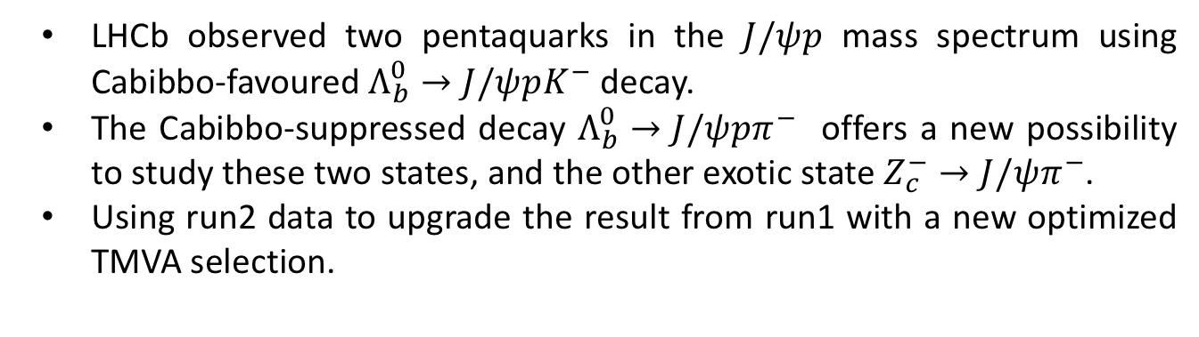
Introduction
LHCb observed two pentaquarks in the $J/ψp$ mass spectrum using Cabibbo-favoured $Λ_{b}^{0}→J/ψpK^{−}$ decay.
The Cabibbo-suppressed decay $Λ_{b}^{0}→J/ψpπ^{−}$ offers a new possibility to study these two states, and the other exotic state $Z_{c}^{−}→J/ψπ^{−}$.
Using run2 data to upgrade the result from run1 with a new optimized TMVA selection.

Slide 3
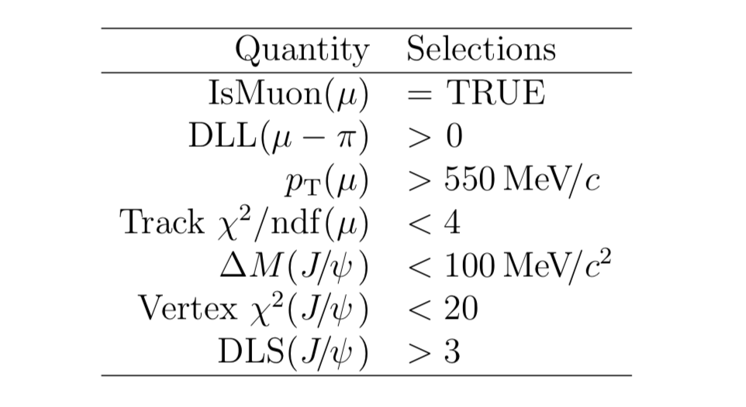
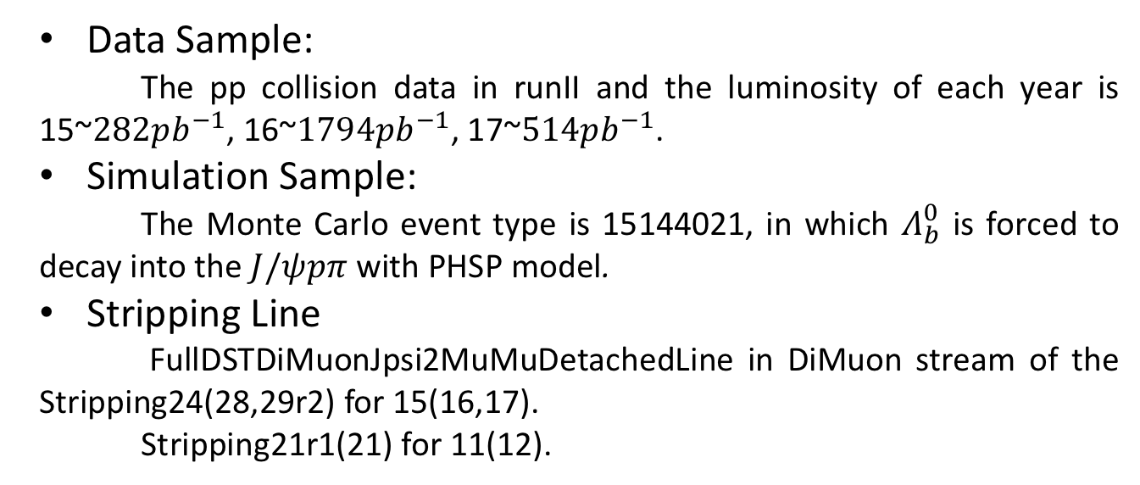
Dataset and Reconstruction
Data Sample:
The pp collision data in runII and the luminosity of each year is 15~$282pb^{−1}$, 16~$1794pb^{−1}$, 17~$514pb^{−1}$.
Simulation Sample:
The Monte Carlo event type is 15144021, in which $Λ_{b}^{0}$ is forced to decay into the $J/ψpπ$ with PHSP model.
Stripping Line
FullDSTDiMuonJpsi2MuMuDetachedLine in DiMuon stream of the Stripping24(28,29r2) for 15(16,17).
Stripping21r1(21) for 11(12).

Slide 4
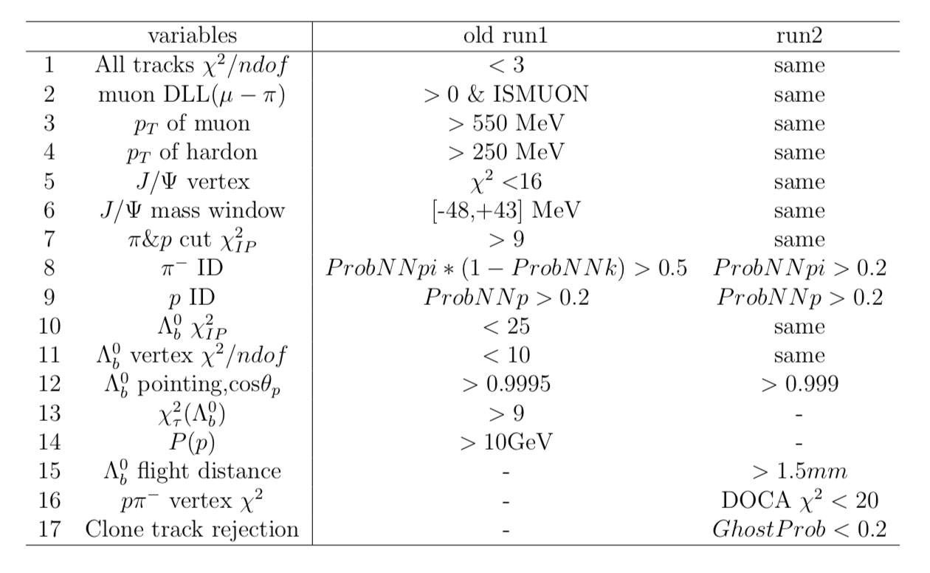
Pre-Selection
HLT1 TOS: Jpsi_DiMuonHighMass | Jpsi_TrackMuon | Lb_TwoTrackMVA |Lb_TrackMVA (No MVA trigger for run1)
HLT2 TOS: Jpsi_DiMuonDetachedJPsi| TopoMu(2,3,4)BodyBBDT

Slide 5
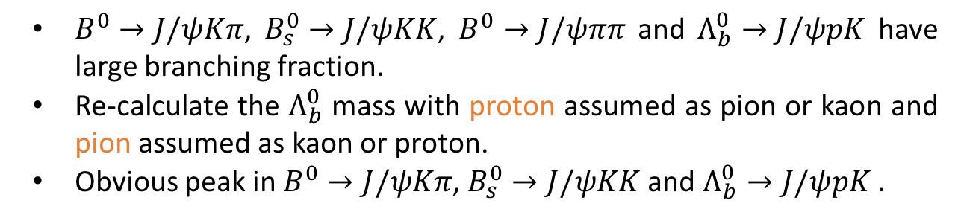
Reflections vetoing
$B^{0}→J/ψKπ$, $B_{s}^{0}→J/ψKK$, $B^{0}→J/ψππ$ and $Λ_{b}^{0}→J/ψpK$ have large branching fraction.
Re-calculate the $Λ_{b}^{0}$ mass with proton assumed as pion or kaon and pion assumed as kaon or proton.
Obvious peak in $B^{0}→J/ψKπ$, $B_{s}^{0}→J/ψKK$ and $Λ_{b}^{0}→J/ψpK$ .

Slide 6
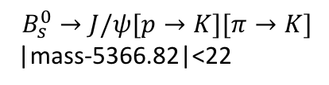
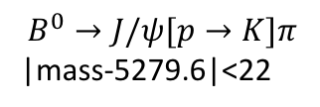
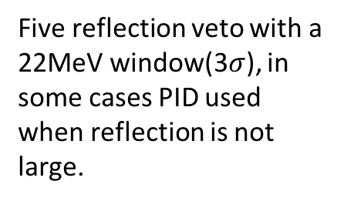
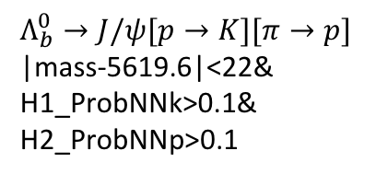
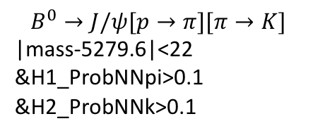
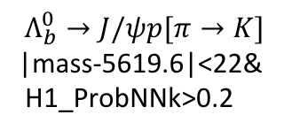
Reflections vetoing
$$B^{0}→J/ψ[p→K]π$$
|mass-5279.6|<22
$$B_{s}^{0}→J/ψ[p→K][π→K]$$
|mass-5366.82|<22
$$Λ_{b}^{0}→J/ψp[π→K]$$
|mass-5619.6|<22&
H1_ProbNNk>0.2
Five reflection veto with a 22MeV window(3$σ$), in some cases PID used when reflection is not large.
$$B^{0}→J/ψ[p→π][π→K]$$
|mass-5279.6|<22
&H1_ProbNNpi>0.1
&H2_ProbNNk>0.1
$Λ_{b}^{0}→J/ψ[p→K][π→p]$
|mass-5619.6|<22&
H1_ProbNNk>0.1&
H2_ProbNNp>0.1

Slide 7
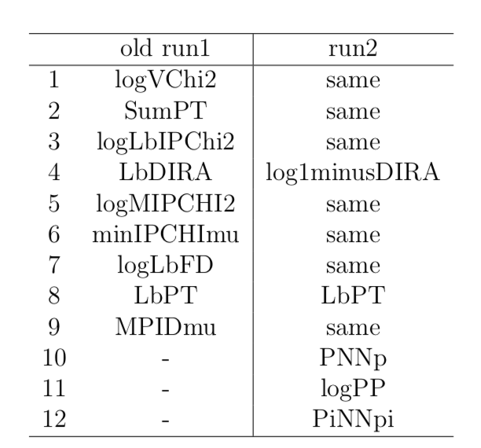
Multivariate analysis
Variables used in the TMVA training of old run1 and run2

Slide 8
Multivariate analysis-run2
MC PID resampled by PIDCalib
PHSP MC vs sideband background >150MeV and <250MeV

Slide 9
Multivariate analysis-run2
No effect of overtraining

Slide 10

Invariant mass fit
After the BDTG cut, check the veto, $Λ_{b}^{0}→J/ψpK$ has a obvious peak.
This reflection has been considered and simulation $Λ_{b}^{0}→J/ψpK$ sample is used to determine the shape.

Slide 11
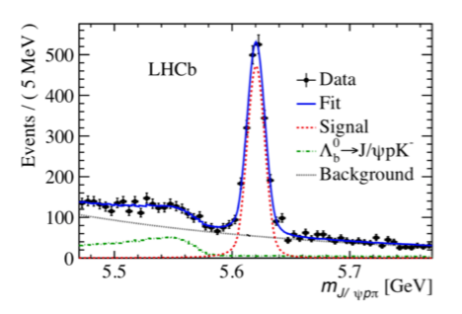
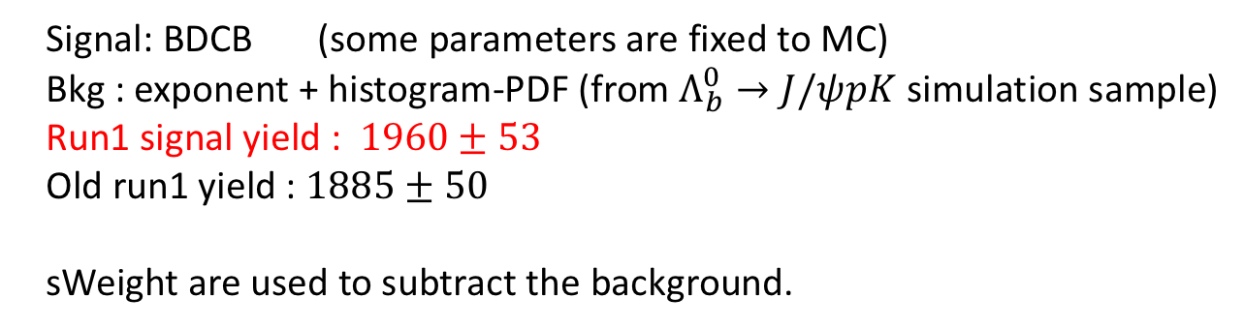
Invariant mass fit-run2
Signal: BDCB (some parameters are fixed to MC)
Bkg : exponent + histogram-PDF (from $Λ_{b}^{0}→J/ψpK$ simulation sample)
Run1 signal yield : $1960±53$
Old run1 yield : $1885±50$
sWeight are used to subtract the background.

Slide 12
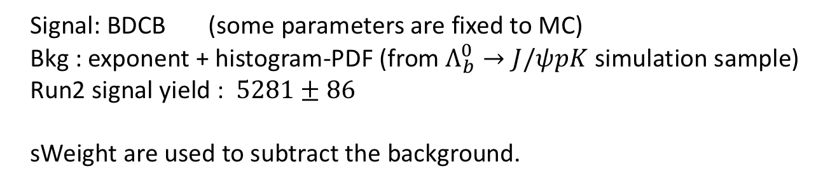
Invariant mass fit
Signal: BDCB (some parameters are fixed to MC)
Bkg : exponent + histogram-PDF (from $Λ_{b}^{0}→J/ψpK$ simulation sample)
Run2 signal yield : $5281±86$
sWeight are used to subtract the background.

Slide 13

Amplitude analysis
Dalitz plots for candidates within $±15$MeV of the $Λ_{b}^{0}$ mass.
Significant $N^{∗}$ contribution are seen.
The projections of the $pπ$ (left) and $J/ψp$ (right) invariant masses.

Slide 14
Amplitude analysis
Efficiencies of signal

Slide 15
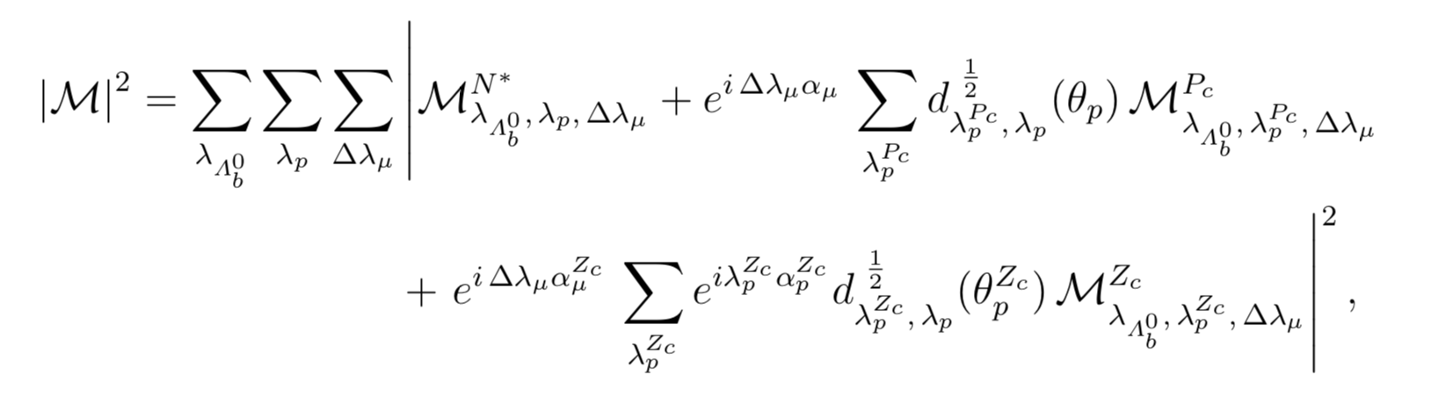
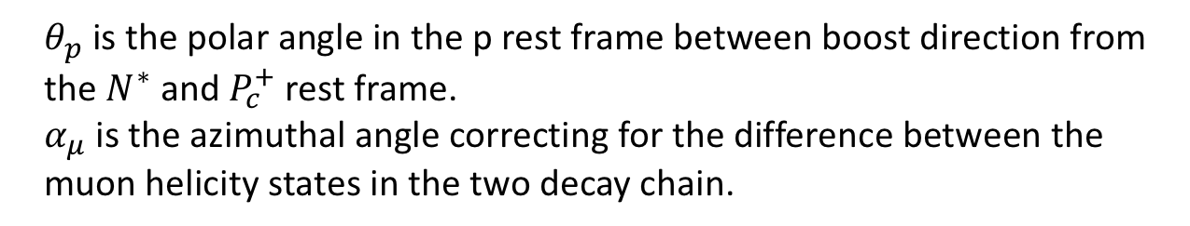
Amplitude analysis – matrix element
Total decay matrix element :
$θ_{p}$ is the polar angle in the p rest frame between boost direction from the $N^{∗}$ and $P_{c}^{+}$ rest frame.
$α_{μ}$ is the azimuthal angle correcting for the difference between the muon helicity states in the two decay chain.

Slide 16
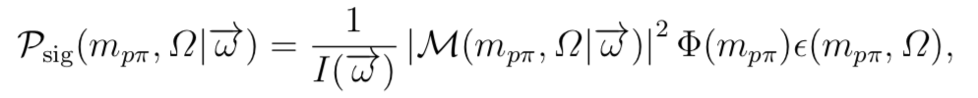
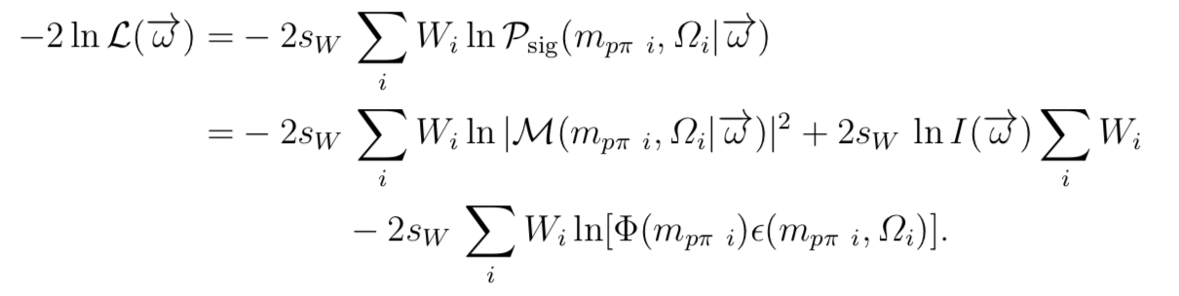
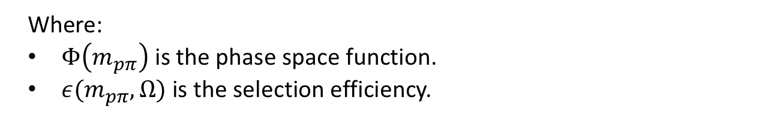
Amplitude analysis – Likelihood
The PDF:
Where:
$Φ\left(m_{pπ}\right)$ is the phase space function.
$ε(m_{pπ},Ω)$ is the selection efficiency.
sPlot technique, to minimize:
No need to parameterize the efficiency.

Slide 17
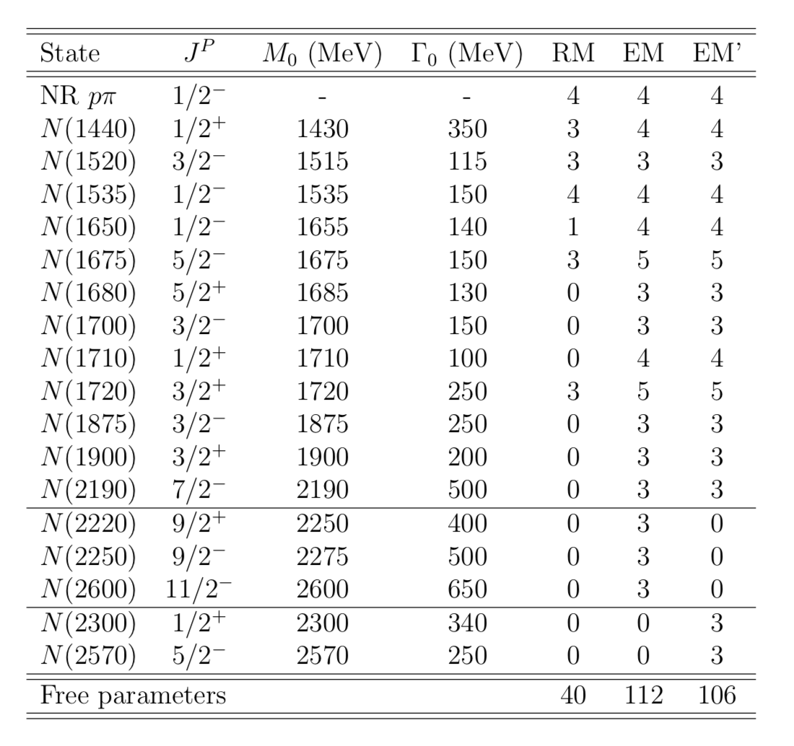


Amplitude analysis – $N^{∗}$ resonances
3 versions $N^{∗}$ model are used in our fit, run1 publication used RM as default fit, EM’ for significance evaluation.

Slide 18
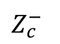
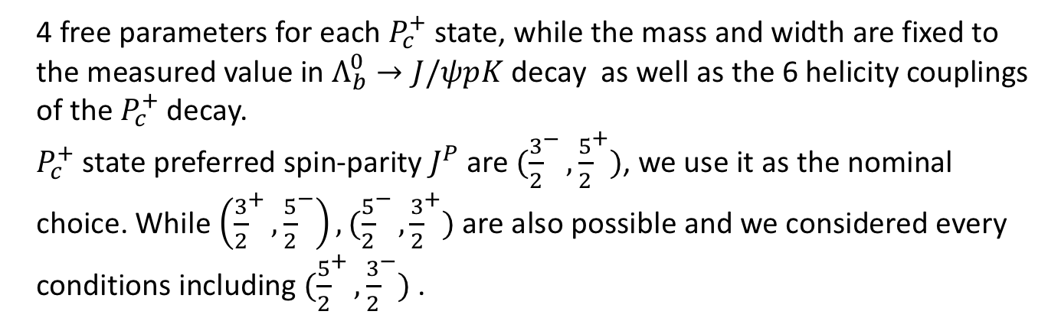
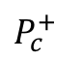

Amplitude analysis – $P_{c}^{+}$ and $Z_{c}^{−}$
4 free parameters for each $P_{c}^{+}$ state, while the mass and width are fixed to the measured value in $Λ_{b}^{0}→J/ψpK$ decay as well as the 6 helicity couplings of the $P_{c}^{+}$ decay.
$P_{c}^{+}$ state preferred spin-parity $J^{P}$ are $({\frac{3}{2}}^{−},{\frac{5}{2}}^{+})$, we use it as the nominal choice. While $\left({\frac{3}{2}}^{+},{\frac{5}{2}}^{−}\right),({\frac{5}{2}}^{−},{\frac{3}{2}}^{+})$ are also possible and we considered every conditions including $({\frac{5}{2}}^{+},{\frac{3}{2}}^{−})$ .
10 free parameters for $Z_{c}^{−}$ state, while mass and width are fixed.
$P_{c}^{+}$
$Z_{c}^{−}$

Slide 19
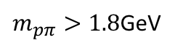

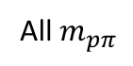
Amplitude analysis – RM-(${\frac{3}{2}}^{−},{\frac{5}{2}}^{+}$)
Fit Projection
All $m_{pπ}$
$m_{pπ}>1.8$GeV

Slide 20
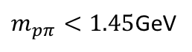
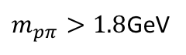

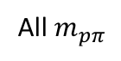
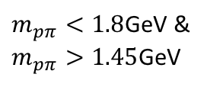
Amplitude analysis – RM- (${\frac{3}{2}}^{−},{\frac{5}{2}}^{+}$)
Fit Projection
$m_{pπ}>1.8$GeV
All $m_{pπ}$
$m_{pπ}<1.45$GeV
$m_{pπ}<1.8$GeV &
$m_{pπ}>1.45$GeV

Slide 21

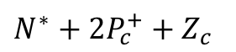
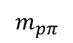
Amplitude analysis – RM- (${\frac{3}{2}}^{−},{\frac{5}{2}}^{+}$)
$N^{∗}+{2P}_{c}^{+}+Z_{c}$
Angular distribution for fit
More plots in backup.
$$m_{pπ}$$

Slide 22
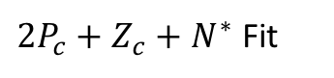
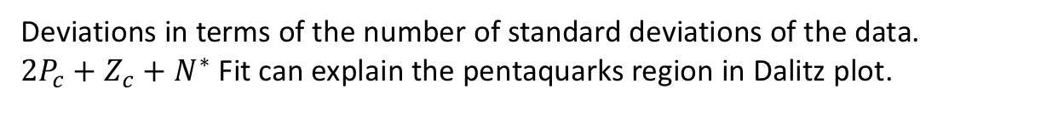


Amplitude analysis – RM- (${\frac{3}{2}}^{−},{\frac{5}{2}}^{+}$)
$2P_{c}+Z_{c}+N^{∗}$ Fit
No $2P_{c}+Z_{c}$ Fit
Deviations in terms of the number of standard deviations of the data.
$2P_{c}+Z_{c}+N^{∗}$ Fit can explain the pentaquarks region in Dalitz plot.

Slide 23
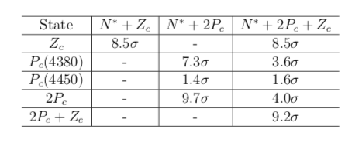
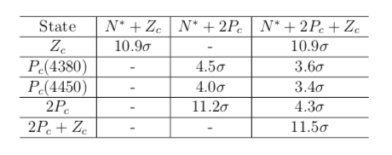
Amplitude analysis – RM
Significance expressed in standard deviations:
Up is run1 data and run1 MC result.
Bottom is run2 data and run2 MC result.

Slide 24
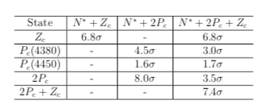
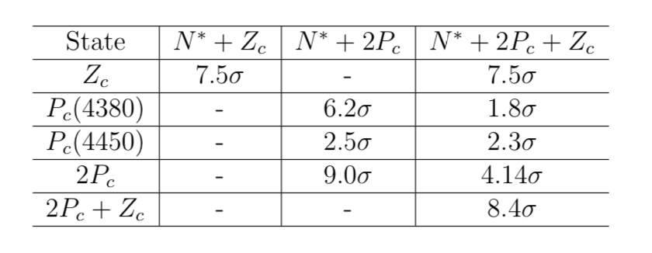
Amplitude analysis – EM
Up is run1 data and run1 MC result.
Bottom is run2 data and run2 MC result.

Slide 25
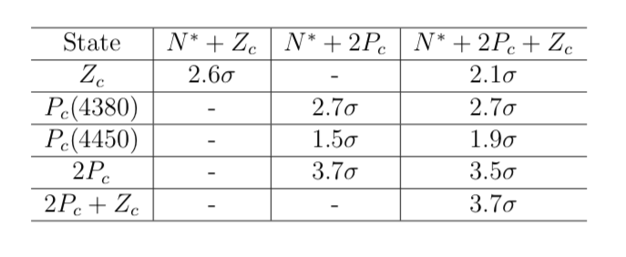
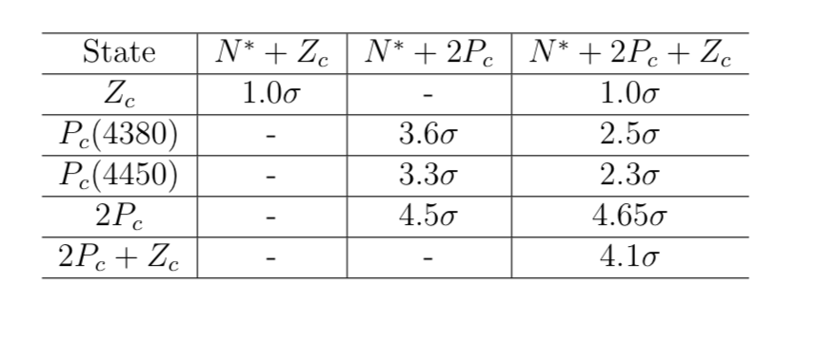
Amplitude analysis – EM’
Up is run1 data and run1 MC result.
Bottom is run2 data and run2 MC result.

Slide 26
Backup

Slide 27
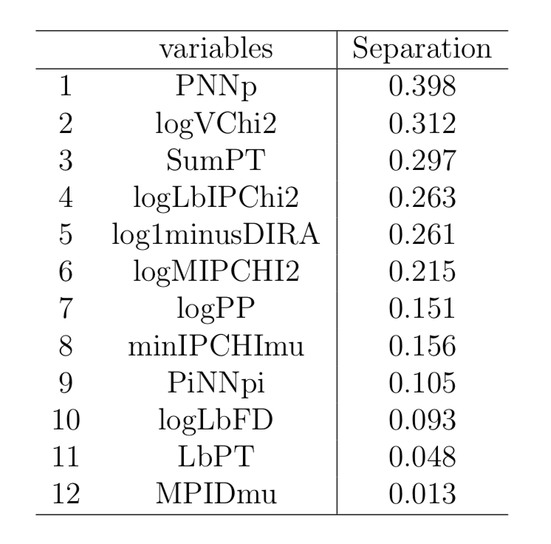
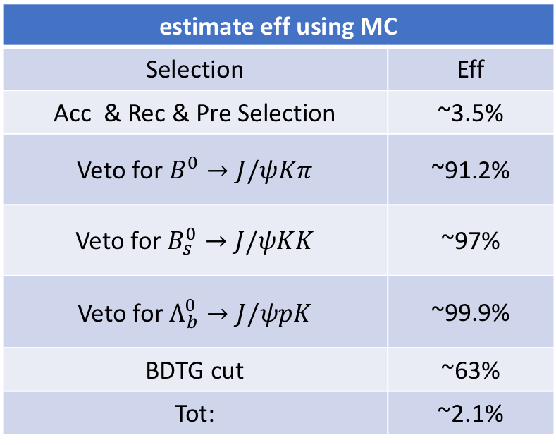
Multivariate analysis
estimate eff using MC
Selection | Eff
Acc & Rec & Pre Selection | ~3.5%
Veto for $B^{0}→J/ψKπ$ | ~91.2%
Veto for $B_{s}^{0}→J/ψKK$ | ~97%
Veto for $Λ_{b}^{0}→J/ψpK$ | ~99.9%
BDTG cut | ~63%
Tot: | ~2.1%

Slide 28
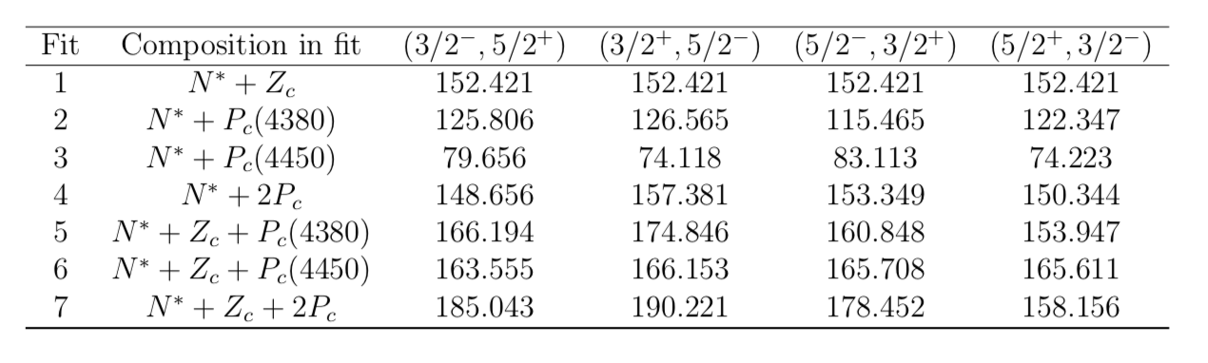
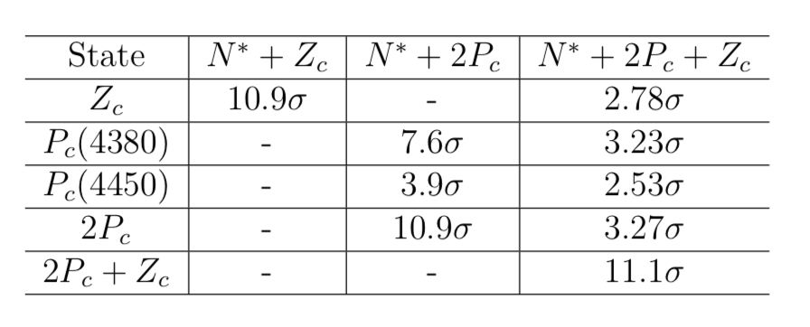
Amplitude analysis – RM
Significance expressed in standard deviations:
Use the $Min(Δ(−2lnL))$ in different $J^{P}$ of $({\frac{3}{2}}^{−},{\frac{5}{2}}^{+})$, $\left({\frac{3}{2}}^{+},{\frac{5}{2}}^{−}\right)and ({\frac{5}{2}}^{−},{\frac{3}{2}}^{+})$.

Slide 29
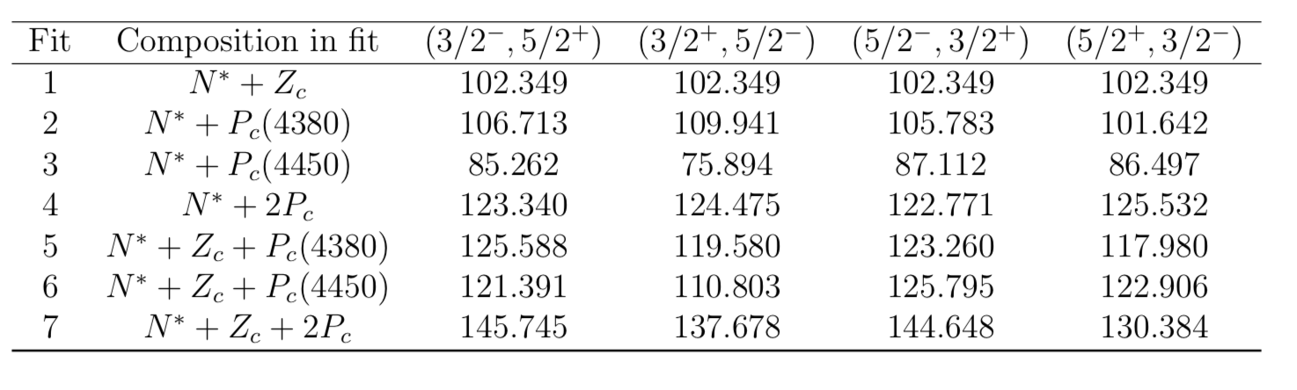
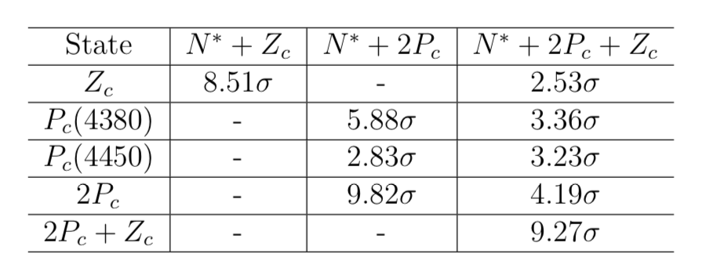
Amplitude analysis – EM
Use the $Min(Δ(−2lnL))$ in different $J^{P}$ of $({\frac{3}{2}}^{−},{\frac{5}{2}}^{+})$, $\left({\frac{3}{2}}^{+},{\frac{5}{2}}^{−}\right)and ({\frac{5}{2}}^{−},{\frac{3}{2}}^{+})$.

Slide 30
Amplitude analysis – RM

Slide 31
Amplitude analysis – RM

Slide 32
Amplitude analysis – RM

Slide 33

Amplitude analysis – EM- (${\frac{3}{2}}^{−},{\frac{5}{2}}^{+}$)
All $m_{pπ}$
$m_{pπ}>1.8$GeV

Slide 34
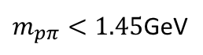
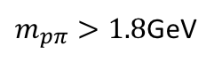
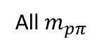

Amplitude analysis – EM- (${\frac{3}{2}}^{−},{\frac{5}{2}}^{+}$)
$m_{pπ}>1.8$GeV
All $m_{pπ}$
$m_{pπ}<1.45$GeV
$m_{pπ}<1.8$GeV &
$m_{pπ}>1.45$GeV

Slide 35
Amplitude analysis – EM’

Slide 36
Amplitude analysis – EM’

Slide 37
Amplitude analysis – EM’

Slide 38


Amplitude analysis – EM’
All $m_{pπ}$
$m_{pπ}>1.8$GeV

Slide 39

Amplitude analysis – EM’
$m_{pπ}>1.8$GeV
All $m_{pπ}$
$m_{pπ}<1.45$GeV
$m_{pπ}<1.8$GeV &
$m_{pπ}>1.45$GeV

Slide 40

Amplitude analysis – EM’
Significance expressed in standard deviations:
Use the $Min(Δ(−2lnL))$ in different $J^{P}$ of $({\frac{3}{2}}^{−},{\frac{5}{2}}^{+})$, $\left({\frac{3}{2}}^{+},{\frac{5}{2}}^{−}\right),\left({\frac{5}{2}}^{−},{\frac{3}{2}}^{+}\right) and\left({\frac{5}{2}}^{+},{\frac{3}{2}}^{−}\right)$.
This Model reduced the significance of $Z_{c}$ and improve the significance of $P_{c}$.

Slide 41

Amplitude analysis – Compare
The $−2lnL$ in different models including $N^{∗}+2P_{c}+Z_{c}$:

Slide 42

Conclusion and Next to do
Significantly better description of the data by either including the two $P_{c}$ or $Z_{c}$.
Next to do :
To check the fit quality more.
Test the new selection and TMVA on run1 data.
To fit adding run1 data together.
Study the systematic uncertainty.
Upgrade the branch fraction of $B(Λ_{b}^{0}→π^{−}P_{c}^{+})/B(Λ_{b}^{0}→K^{−}P_{c}^{+})$.

Slide 43


Amplitude analysis – matrix element
In the $N^{∗}$ decay chain:
No polarization for $Λ_{b}^{0}$.

